Slide 1





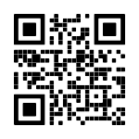
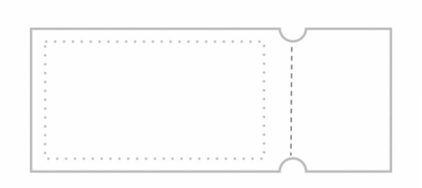
TrickVR
.
T
K
R
C
I
I
C
R
K
.
T
.
T
K
R
C
I
I
C
R
K
T
.
.
T
K
R
C
I
I
C
R
K
T
.
.
T
K
R
C
I
I
C
R
K
T
.
.
T
K
R
C
I
I
C
R
K
T
.
T
.
K
R
C
I
I
C
R
K
T
.
.
K
C
T
I
R
400 Lyle Street,
London ON.
N5W 4Z2
info@trickvrgamingﬁesta.ca
+1 437-6636-979
Promo: $30 off 1st purchase
$10 off subsequent purchases
We make your VR Party experience memorable

